Slide 1
Insight 4.0 Web Portal Automation
NEC QA Team

Slide 2
Automation Topology

Slide 3
Software I
Step 1.Install Active TCL v8.4.20-32 bit
Ftp://10.40.1.184/software/ActiveTcl8.4.20.0.297203-win32-ix86-threaded.exe
Step 2.Install SVN
Ftp://10.40.1.184/software/TortoiseSVN-1.8.8.25755-x64-svn-1.8.10.msi
Step 3. Install Spirent TestCenter
Ftp://10.40.1.184/software/SpirentTestCenter
Step 4. Install IXIA
Ftp://10.40.1.184/software/IXIA

Slide 4
Software II
Step 5.install jdk 1.8
http://www.oracle.com/technetwork/java/javase/downloads/jdk8-downloads-2133151.html
Step 6.install spring-tool-suite
http://spring.io/tools/sts
Step 7.install testNG in Spring-tool-suite
http://testng.org/doc/download.html

Slide 5
Set Environment Variables
System Path:
C:\Tcl\bin;C:\Program Files\Ixia\IxOS\8.01-EA;C:\Program Files\Ixia\IxOS\8.01-EA\TclScripts\bin;C:\Program Files\Wireshark;%PATH%;C:\ProgramData\Oracle\Java\javapath;%SPIRENT_TESTCENTER_HOME%Spirent TestCenter Application;%SystemRoot%\system32;%SystemRoot%;%SystemRoot%\System32\Wbem;%SYSTEMROOT%\System32\WindowsPowerShell\v1.0\;c:\Program Files\Microsoft SQL Server\100\Tools\Binn\;c:\Program Files\Microsoft SQL Server\100\DTS\Binn\;C:\Program Files\Microsoft SQL Server\90\Tools\binn\;C:\Program Files\Spirent Communications\Spirent TestCenter\;%SPIRENT_TESTCENTER_HOME%\Administration Application;C:\Program Files\Spirent Communications\Spirent TestCenter\TCL\bin;C:\Program Files\HP\Unified Functional Testing\bin;C:\Program Files\TortoiseSVN\bin;C:\Program Files\Ixia\Tcl\8.5.17.0\bin;C:\Program Files\Ixia\Perl\site\bin;C:\Program Files\Ixia\Perl\bin;%JAVA_HOME%\bin;

Slide 6
Set Environment Variables
User<administrator> JAVA_HOME:
C:\Program Files\Java\jdk1.8.0_151
User<administrator> CLASSPATH:
.;%JAVA_HOME%\lib\dt.jar;%JAVA_HOME%\lib\tools.jar;
User<administrator> TCLLIBPATH:
C:/Program Files (x86)/Spirent Communications/Spirent TestCenter/TCL C:/Program Files (x86)/Ixia/IxOS/8.01-EA/TclScripts
User<administrator> Path:
C:\Tcl\bin;C:\Program Files (x86)\Ixia\IxOS\8.01-EA;C:\Program Files (x86)\Ixia\IxOS\8.01-EA\TclScripts\bin;C:\Program Files (x86)\Spirent Communications\Spirent TestCenter;C:\Program Files (x86)\Spirent Communications\Spirent TestCenter\TCL\bin%PATH%

Slide 7
Copy Ixia/Spirent lib files
Copy: "C:\Program Files (x86)\Spirent Communications\Spirent TestCenter\TCL\lib\stc" to "C:\Tcl\lib"
Copy: "C:\Program Files (x86)\Ixia\IxOS\8.01-EA\TclScripts\lib\ixTcl1.0" to "C:\Tcl\lib"
Copy: "C:\Program Files (x86)\Spirent Communications\Spirent TestCenter\Spirent TestCenter Application\tclstruc.dll" to "C:\Tcl\bin"
Copy: "C:\Program Files (x86)\Spirent Communications\Spirent TestCenter\Spirent TestCenter Application\mainlibtcl83.dll" to "C:\Tcl\bin"
Copy: "C:\Program Files (x86)\Spirent Communications\Spirent TestCenter\Spirent TestCenter Application\hwUtil.dll" to "C:\Tcl\bin"
Copy: "C:\Program Files (x86)\Spirent Communications\Spirent TestCenter\Spirent TestCenter Application\mainlib.dll" to "C:\Tcl\bin"
Copy: "C:\Program Files (x86)\Spirent Communications\Spirent TestCenter\Spirent TestCenter Application\paf.dll" to "C:\Tcl\bin"
Copy: "C:\Program Files (x86)\Spirent Communications\Spirent TestCenter\Spirent TestCenter Application\PCS.dll" to "C:\Tcl\bin"
Copy: "C:\Program Files (x86)\Spirent Communications\Spirent TestCenter\Spirent TestCenter Application\tclpaftc.dll" to "C:\Tcl\bin"
Copy: "C:\Program Files (x86)\Spirent Communications\Spirent TestCenter\Spirent TestCenter Application\tclpcs.dll" to "C:\Tcl\bin"

Slide 8
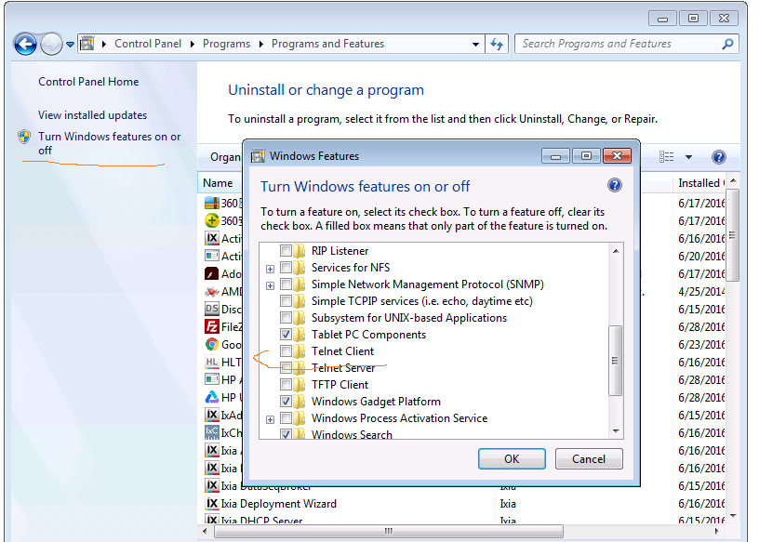
Turn off telnet client service on system
1: Copy file < C:\AUTOMATION\BIN\telnet\telnet.exe> to C:/Windows/SysWOW64
2: Copy file < C:\AUTOMATION\BIN\telnet\expect543.dll> to C:\Tcl\lib\expect
3: Copy file < C:\AUTOMATION\BIN\telnet\closewin.exe> to C:\Tcl\bin
4. Click SocketReg to register(path: C:\AUTOMATION\BIN\Dimac\w3Sockets)

Slide 9
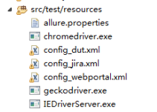
TestCase Config
src/test/resoueces:
seleniumdriver :
Chromedriver.exe (for chrome)
geckodriver.exe (for firefox)
IEDriverServer.exe (for IE)
config_dut.xml (config all devices)
config_webportal.xml(web portal)

Slide 10
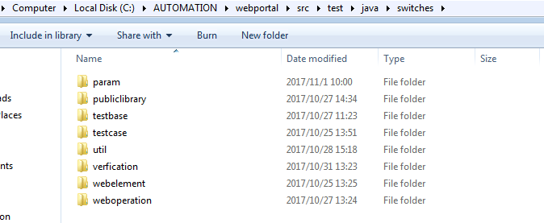
Code Catalog

Slide 11
Code Catalog
param: include global param. Reading from config_*.xml
publiclibrary: include some public script .such as login. Click [apply] button ,Click alert
testcase:include all testcase
testbase:testcase extendsTestCaseBase
util：include command line. java socket,read xml
webelement: include all web page element.
weboperation: use webelement to operate GUI

Slide 12
Demo
public class Testcase extends TestCaseBase {
@Test
public void Test1() {
//declare start with dut webpage
DUT dut = new DUT();
//use publiclibrary to login
Login.login();
//enter switching-port-configuration page
SwitchingPortsPortconfiguration switchingPortsPortconfiguration = new SwitchingPortsPortconfiguration();
//linkup A01 port
switchingPortsPortconfiguration.setPortConfiguration(GlobalParam.A01);
//use publiclibrary to logout
Login.logout();

Slide 13
Demo
// send traffic
Command command = new Command();
command.runTclShell();
/use java socket to connection tcl
Javasocket javasocket = new Javasocket();
javasocket.WakeUpTclShell();
javasocket.WaitForTclShell();

Slide 14
Demo
// declare start with dut webpage
SW1 sw1 = new SW1();
Login.login();
Login.logout();
//send param to tcl
javasocket.SendParamToTclShell("portA", GlobalParam.A01);
//read result from tcl
MicResult = javasocket.readResultFromTclShell();
//TestNG verification MicResult，mark as test pass or fail
assertTrue(MicResult);
}
}

Slide 15
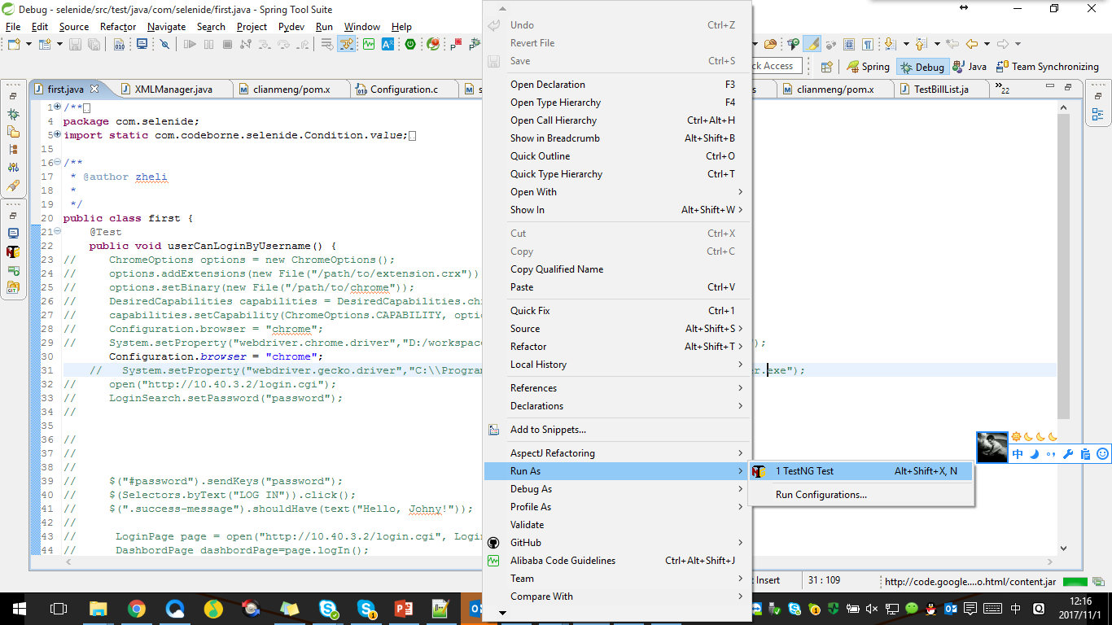
How to run?
Run single case: use spring-tool-suite,open testcase right click code windows, choice->Run AS->TestNG Test

Slide 16
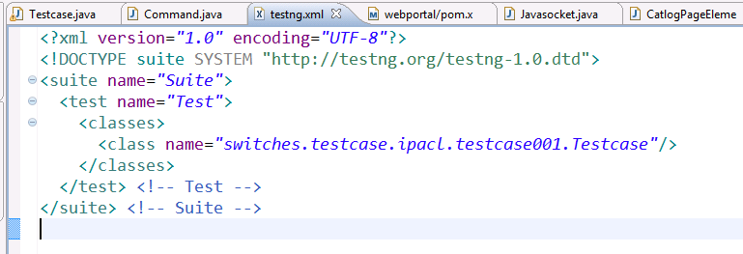
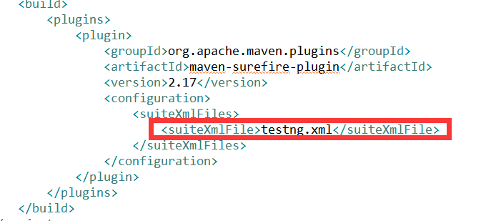
Run test suite： Step1:build a testing.xml, configure which test case want to run
How to run?
Step 2: use command “mvn test” in Jenkins or spring-tool-suite

Slide 17
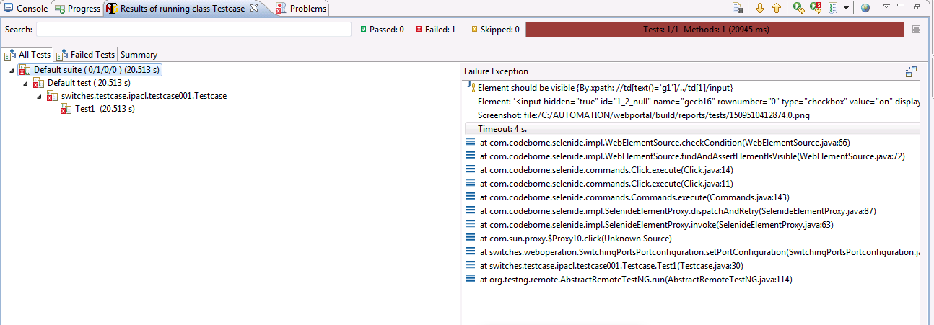
Debug Result
Testng result window will show which line and which element not found and create a screenshot

Slide 18
Next Steps
Integrate testing logs into Jenkins
Wrapper-up TCL call functions
…….

